Slide 1
Path tracing general idea & pseudocode
Similar to project 3-1, we estimate by 2 parts :
zero-bounce light and at least-one-bounce light.
But different than the previous project, the light might reflect or scatter in the air before it hits anything.
So we take that into consideration when we trace it. We integrate by having multiple sample points along each path and than do russian roulette to get the estimate .

Slide 2
Pseudocode for L(Point P’, wo) (at_least_one_bounce)
Sample Distance Dist; //sample distance
Light L.type = random(Scattering, Reflection); //light bounce from P
P = Point of dist away from P’; //convert distance to point
Wi, pdf = P.samplebrdf(); //sample brdf
Cpdf = continuationProabability(p.prdf,wi,wo);
if(random01()<cpdf){ //continue ray tracing
if(type == Reflection){
L += L(P’, -wi)*p.brdf(wi,-wo)*costhea/pdf/cpdf; //reflection from this point
}else{L+= L(P’,-wi)*p.brdf(wi,-wo)*constant/pdf/cpdf;} }// scattering
Return L;

Slide 3
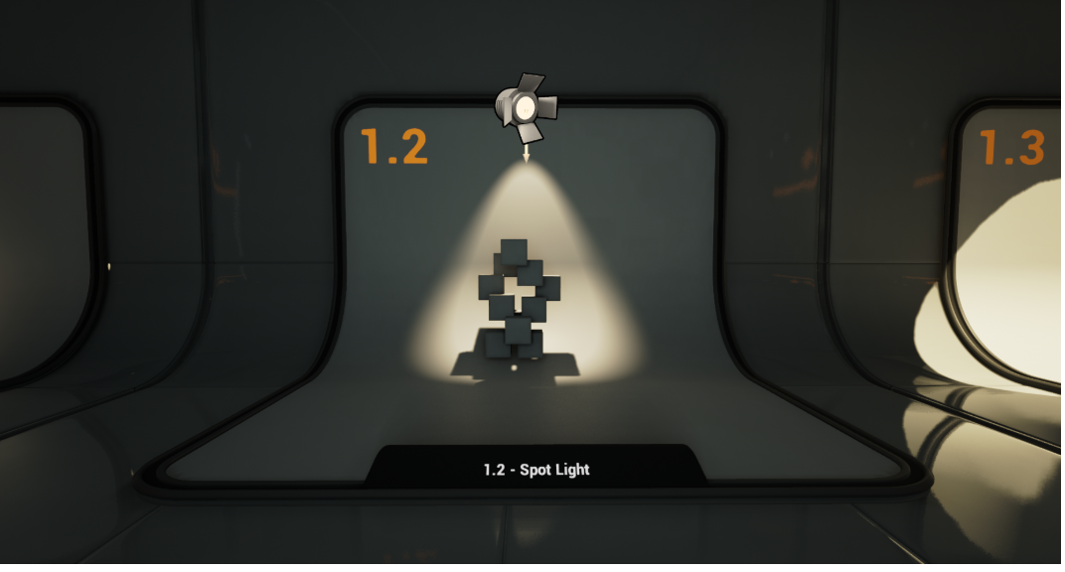
Other changes
Light source :
Changing from Point light to Spot light
Implemented additional codes in CGL src code to simulate this kind light when rendering

